Slide 1
Direct Marketing Optimization
Bhavya Bhambri

Slide 2


Business Context:
Banks offer multiple financial products such as Loans, Credit Cards, and Mutual Funds. However, not every customer responds the same way to each product offer. Mass marketing leads to low conversion rates and inefficient use of marketing budgets
The Challenge
How can we identify the best financial product to offer each client in order to maximize expected revenue?
Constraints
- Contact Limitation: The bank can reach out to only 15% of clients (approximately 100 individuals)
- Single Offer Per Client: Each client can receive only one marketing offer. For example, a client might receive an offer for a consumer loan, a new credit card, or an investment in mutual funds based on their profile and financial behavior.

Slide 3
KEY INSIGHTS
Consumer Loan Propensity model was based on Logistic Regression algorithm with an AUC of 0.63 and F1 Score of 0.47.
Credit to Debit Ratio and Current Accounts Balance are the top indicators in predicting customer’s propensity to buy a Consumer Loan
Mutual Funds Propensity model was based on RandomForest Classification algorithm with an AUC of 0.6 and F1 Score of 0.2
Volume of credit transactions in current account,account balance in current account, no of existing MF accounts were some of the top indicators
Credit Cards model was based on RandomForest Classifier with an AUC of 0.63 and F1 score of 0.33
Account Balance,Credit to Debit Ratio and also Gender are some of the indicators
Top Offers were selected based on Maximum Expected Revenue amongst the 3 products per customer.
The customers with highest Expected Revenue were prioritised and top 100 customers accounted for Total Revenue of 1,337 EUR

Slide 4
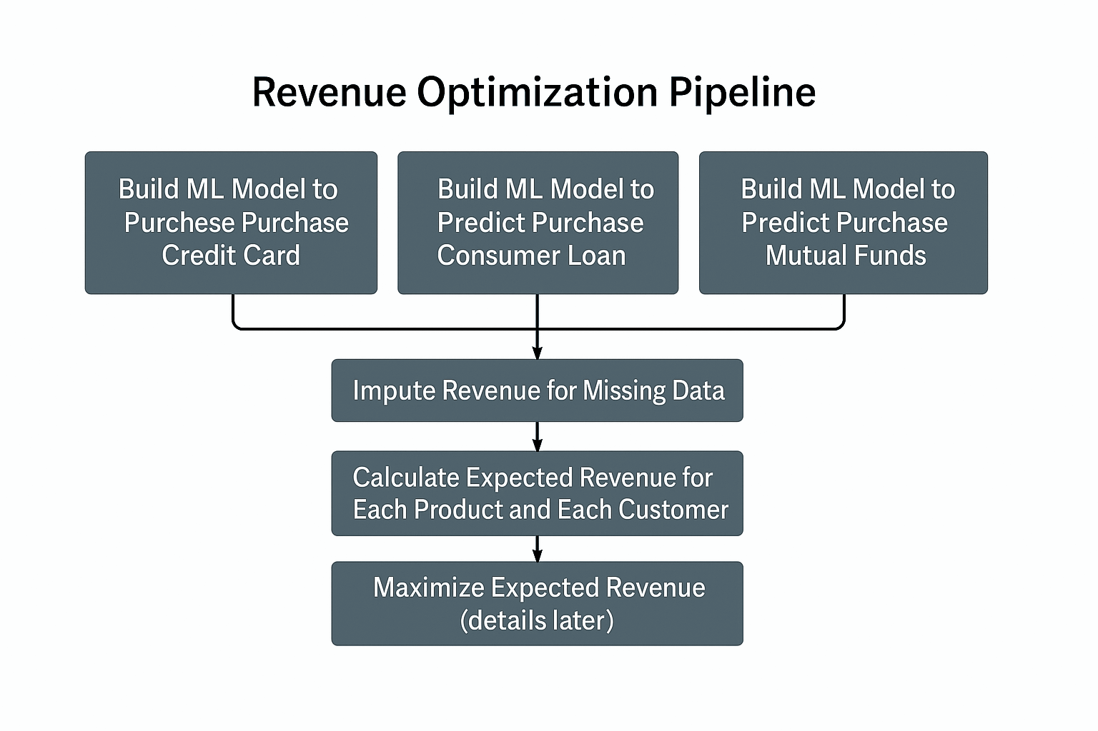
PROBLEM SOLUTION FRAMEWORK
The methodology proposed aims to optimize personalized product recommendations by building separate machine learning models.
Once these probabilities are estimated, missing revenue values are imputed to ensure data completeness.
Using the predicted propensities and revenue figures, expected revenue is calculated for each product and customer.
Finally, the product with the highest expected revenue is selected as the best offer, enabling the bank to maximize overall marketing effectiveness and returns.

Slide 5
Understanding Data
Labeled Dataset (60%)
Unlabelled Dataset (40%)
No of customers n=1615
Randomly Split into Train and Test Dataset
Later Cross Validation is also used to identify the best Model
Model Trained on Labeled Dataset is then used to predict Sale for various products and Revenue is imputed
Demographics
gender
age [years]
tenure with the bank [months]
Product Holding and Volumes
Current accounts balance and number of live accounts
Savings Accounts balance & number of live accounts
Similarly for Mutual Funds,Overdrafts,Credit Cards and Consumer Loans
Financial Transactions
Monthly Credit/Debit Turnover
Total no of Transactions
Total no of Cashless Transactions etc
Sales & Revenue (Target*)
Sale of Mutual Funds
Sale of Credit Cards
Sale of Consumer Loans
Revenue from Mutual Funds
Revenue from Credit Cards
Revenue from Consumer Loans
*Only available for 60% of the customers

Slide 6

Model Training Process
Combining Different Datasets
Consumer Loans Dataset
Feature Engineering**
(missing data imputation, log transformation of highly skewed features eg: account balance-related features, binning features such as Age and Tenure, creating new features such as credit/debit ratio etc, checking for highly correlated features,
Removal of features with high VIF>10 removed to remove multi-collinearity)
02. Credit Card Dataset
Mutual Funds Dataset
Feature Selection
(Using VIF to remove features with high multi-collinearity and then using RandomForest Classifier to select top 10/20 features based on feature importance to be used for the model)
Sampling , Hyperparameter Tuning & Model Selection
(Sampling was done on training dataset to ensure balanced datasets. Using various classification algorithms and hyperparameter-tuning to identify optimal model parameters and the best model based on AUC)
** Check Appendix for Details on Feature Engineering

Slide 7
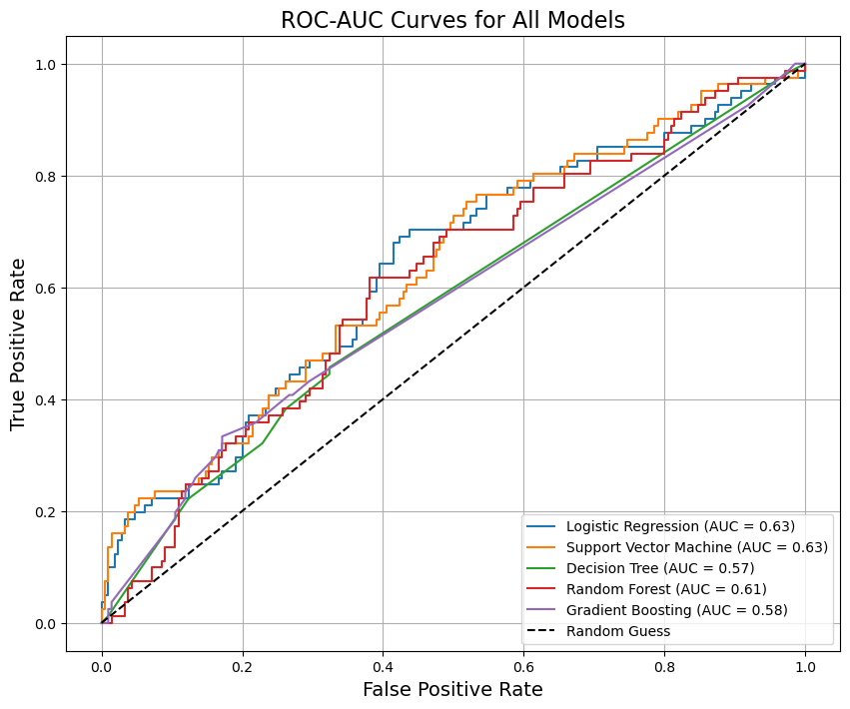
Model Results*
Model Performance After Hyperparameter Tuning on Test Dataset
Consumer Loans Model
Model | Accuracy | Precision | Recall | F1-Score | AUC-ROC
Logistic Regression | 0.6117 | 0.3824 | 0.6420 | 0.4793 | 0.6310
Support Vector Machine | 0.7388 | 0.7778 | 0.0864 | 0.1556 | 0.6339
Decision Tree | 0.6460 | 0.3514 | 0.3210 | 0.3355 | 0.5728
Random Forest | 0.6323 | 0.3523 | 0.3827 | 0.3669 | 0.6100
Gradient Boosting | 0.7216 | 0.0000 | 0.0000 | 0.0000 | 0.5761
Logistic Regression Model is selected as the best model with Test AUC 0.63 and F1 score =0.47
*Check Appendix For Credit Card and Mutual Funds Model

Slide 8
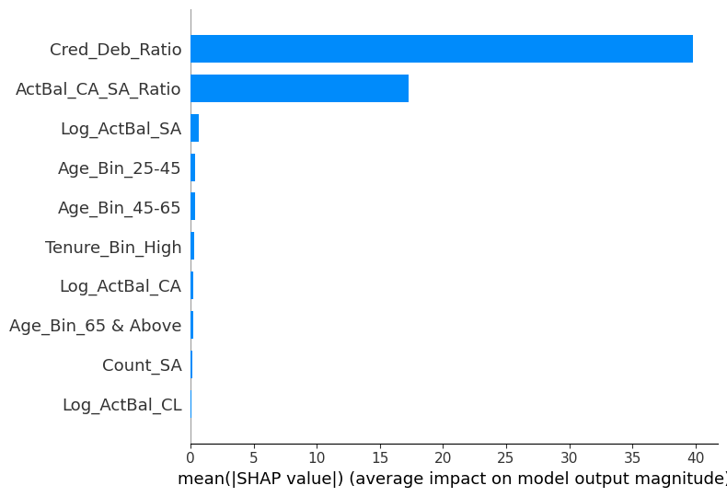
Feature Importance*
Consumer Loans Model
The most important feature is the Credit to Debit Ratio, followed by Actual Balance Ratio of Current Account and Saving Account
*Check Appendix For Credit Card and Mutual Funds Model

Slide 9
Revenue Imputation of Missing Data Values
1. The probability of Purchase of Consumer Loans,Mutual Funds & Credit Cards were predicted using the selected best models.
2. The Revenue for Customers with missing Sale target variables for each product was calculated based on :
If Sales target is missing and Predicted Sale target=1
then Revenue Imputed = Median of Customers with Actual Sale target =1
**The assumption is that the Revenue for different products is not highly skewed with low variance, otherwise a regression model can be built to predict Revenue for each customer and product

Slide 10
Top Offer Recommendation Strategy with Revenue Optimization
Expected Revenue of Each Product for each Client
For each customer & product - consumer loan, MF and Credit Card, calculate Expected Revenue = Sales target (0/1)* Probability to Purchase*Revenue per client per offer
02. Maximum of Expected Revenue
Identify the Product with maximum Expected Revenue
for each customer
03. Customer Score and Top Offer Selected
Score = Max of Expected Revenue
Top Offer = Product corresponding to the MAX Expected Revenue
Recommend Top Offer to top 100 customers (sorted by Score in descending order) calculated in the previous step
04. Recommendation to Top 100 Customers

Slide 11
Example :
Client | P_Loan | Rev_Loan | EV_Loan | P_MF | Rev_MF | EV_MF | P_Card | Rev_Card | EV_Card | Best Offer | Score/MAX EV
A | 0.3 | 2000 | 600 | 0.4 | 2500 | 1000 | 0.1 | 1000 | 100 | MF | 1000
B | 0.5 | 2500 | 1250 | 0.1 | 2500 | 250 | 0.6 | 1000 | 600 | Loan | 1250
For Customer A, Mutual funds is the best offer as the EV for MF is the highest.
Similarly, for Customer B, Loan is the best offer as the EV for Loan is the highest.
Customer B ranks above A as per the methodology sinc B has higher score than A.

Slide 12
Top 100 Customers Selection and Revenue Calculation
Top 100 customers were selected based on Score calculated using the methodology discussed and recommended Offers with Maximum Revenue are shared : ModelOutput/Top_100_Customers.csv
The Top 100 Customers contribute to :
Sum of Top Offer based Expected Revenue of 100 Customers = 1337 EUR

Slide 13
Thank You

Slide 14
Appendix

Slide 15
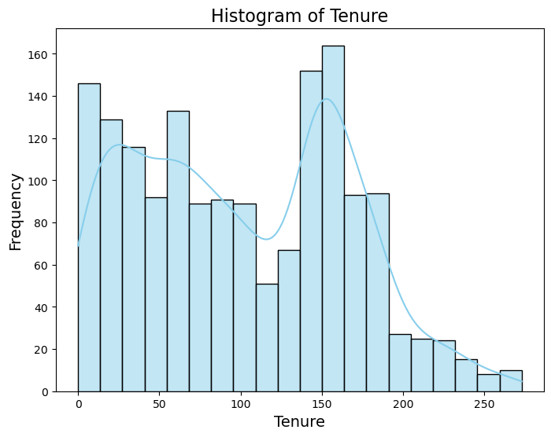
Appendix: Highly Correlated Features (Correlation>0.9)
Binning of Features
Feature 1 | Feature 2 | Correlation
Count_MF | Total_Accounts | 0.996
Log_TransactionsCred | Log_TransactionsCred_CA | 0.910
Log_VolumeDeb | Log_VolumeDeb_CA | 0.986
Log_VolumeDebCash_Card | Log_TransactionsDebCash_Card | 0.870
Log_VolumeDebCashless_Card | Log_TransactionsDebCashless_Card | 0.930
Log_VolumeDeb_PaymentOrder | Log_TransactionsDeb_PaymentOrder | 0.900
Log_TransactionsDeb | Log_TransactionsDeb_CA | 0.969
Tenure Bin | Count
Low | 410
Medium-Low | 402
Medium-High | 406
High | 397

Slide 16
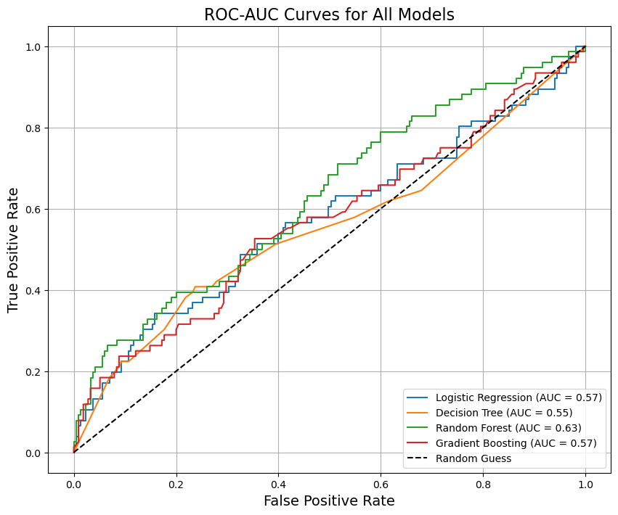
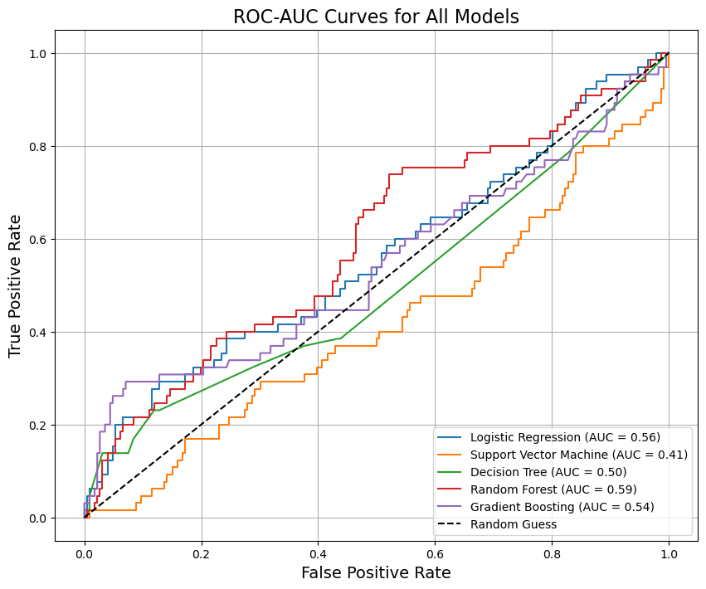
Model Performance
Credit Cards Model
Mutual Funds Model

Slide 17
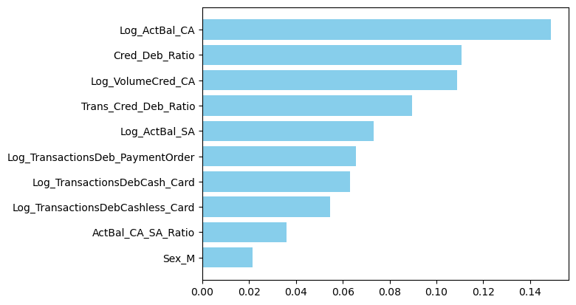
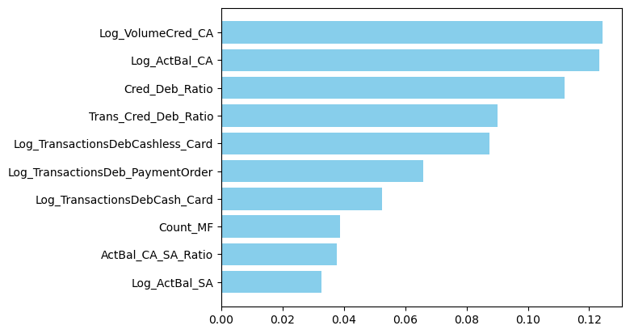
Feature Importance
Credit Cards Model
Mutual Funds Model

